Slide 1
A BLOCKCHAIN BASED SOLUTION TO KNOW YOUR CUSTOMER(KYC)

Slide 2
RELEVANCE OF TOPIC
Know Your customer is one of the banking regulations that the banks are required to perform to identify their customer.
Ensure that the customers are actually who they are claim to be.

Slide 3
DESCRIPTION OF THE PROJECT
Know Your Customer (KYC) is the mandatory process of identifying and verifying the client’s identity when opening an account . It is the first step in a customer relationship with bank. This process will help to ensure that banks services are not misused.KYC procedure is to be completed by the banks while opening accounts and also periodically update the same.
KYC process includes ID card verification, document verification such as utility bills as a proof of address
Banks may refuse to open an account if the clients fails to meet minimum KYC requirements.

Slide 4
OBJECTIVE OF THE STUDY
It improves security
It helps to prevent banks details are misused.

Slide 5
EXISTING SYSTEM
Currently KYC process is done manually as verification of the documents.
Manual KYC based approaches suffer from the drawback that it requires a lot of human intervention and often requires repetitive work.

Slide 6
PROPOSED SYSTEM
Digital KYC approaches can be used to avoid repetitive work.
KYC details should be an immutable state to an attacker but at the same time it should be easily modified by an authorized entity like bank.

Slide 7
MODULES
Bank:
-validating
- Updation and deletion-Banks are authorized to view as well as update the user KYC details .
Users:
-user can register in kyc form
-user can upload details

Slide 8
implementation details
HTML & CSS
Solidity
Metamask
Ganache

Slide 9
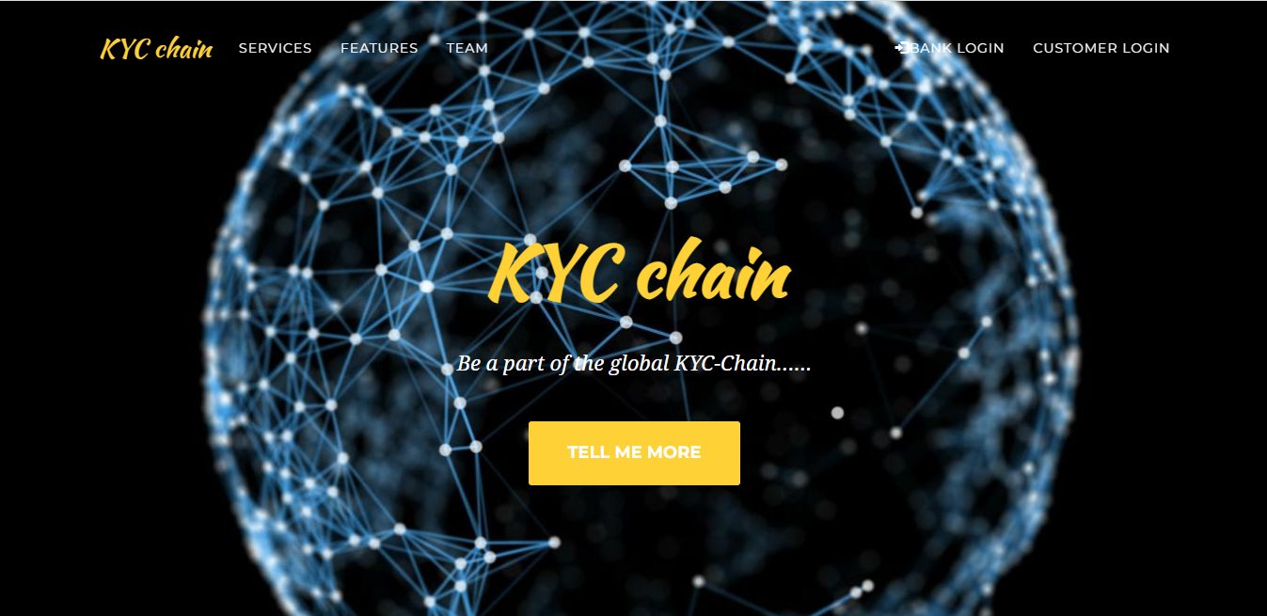
Simple screenshots

Slide 10
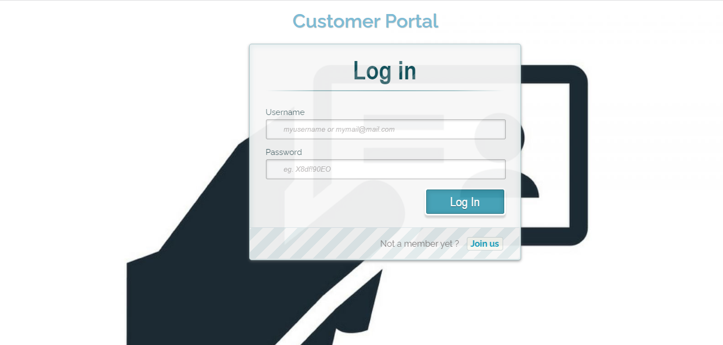

Slide 11
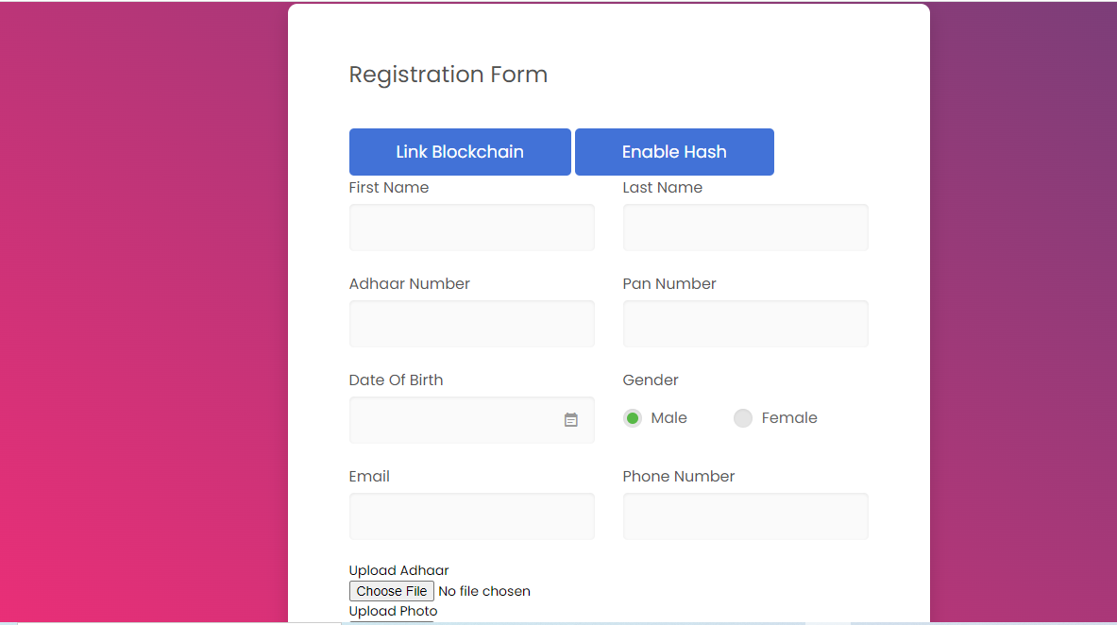

Slide 12
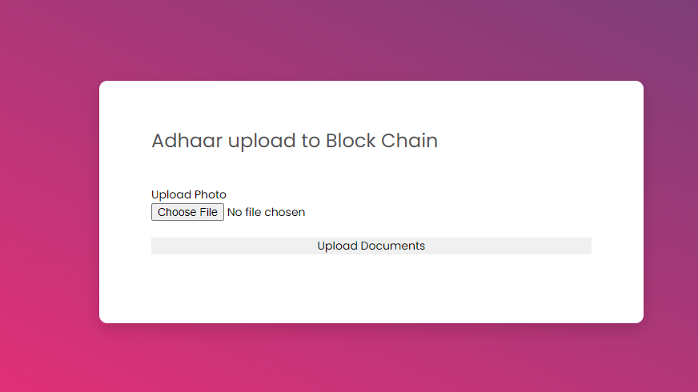

Slide 13
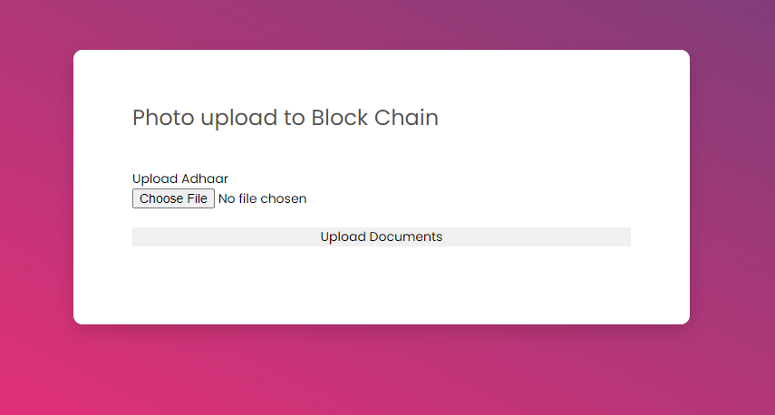

Slide 14
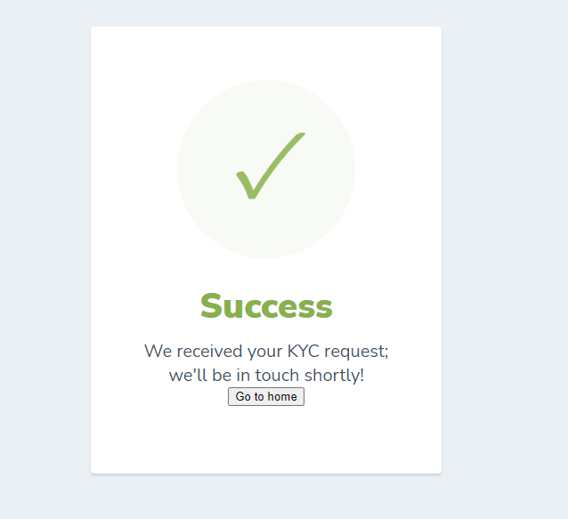

Slide 15
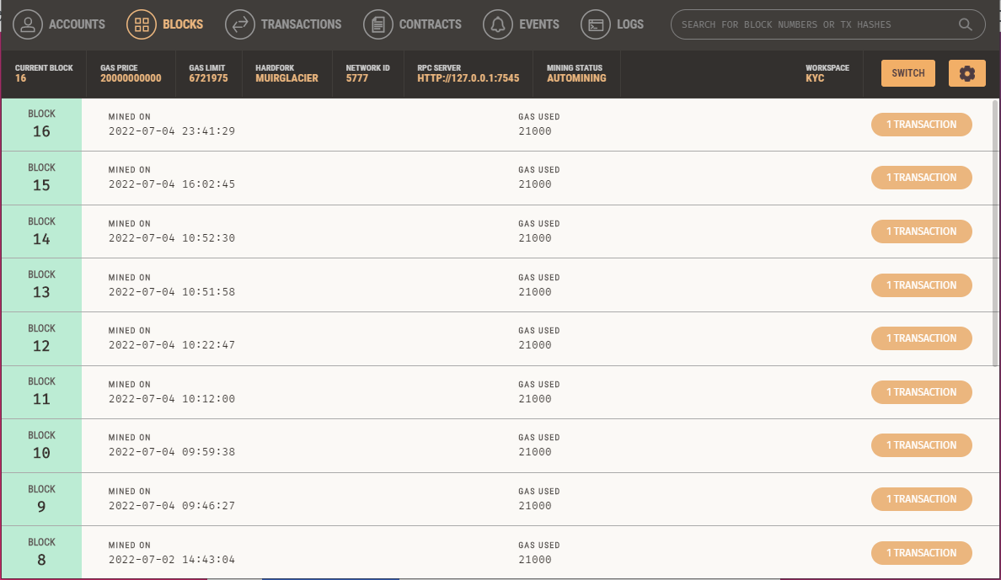

Slide 16
Thank you

